Slide 1
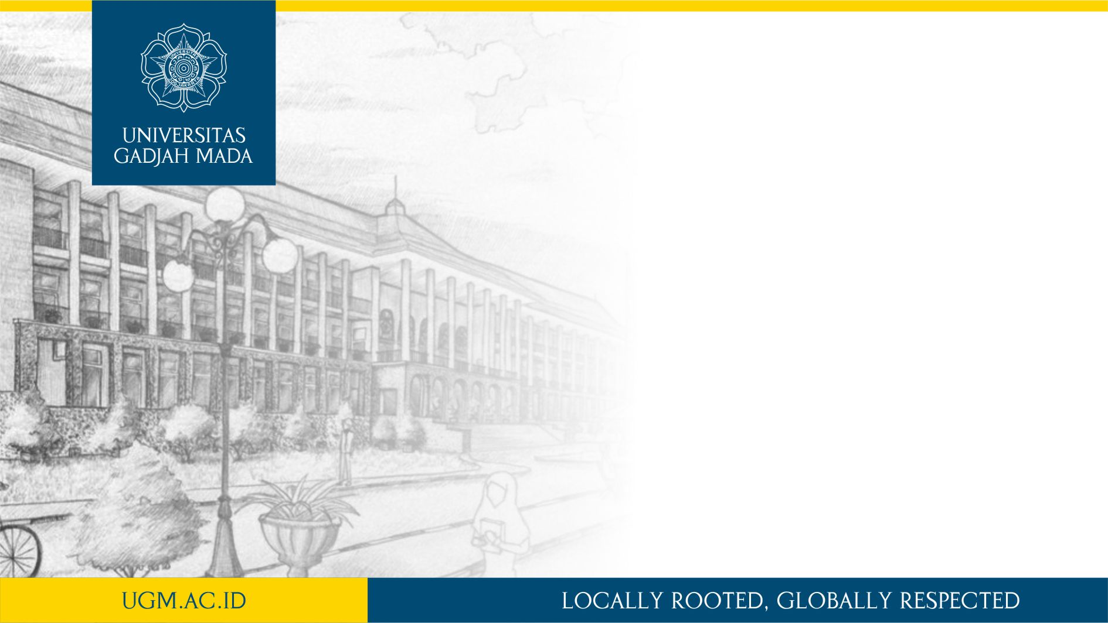
Dasar Pengolahan Citra dengan OpenCV
14 February 2018
Matkul: Pengolahan Citra Digital
Dany Laksono | Dept. Teknik Geodesi UGM

Slide 2

Dasar Pengolahan Citra dengan OpenCV
Review: struktur data citra digital
Pengolahan Citra dengan OpenCV
Pengenalan OpenCV dan Python
Operasi citra digital dengan OpenCV
Praktek Pengolahan Citra Digital dengan OpenCV-Python

Slide 3
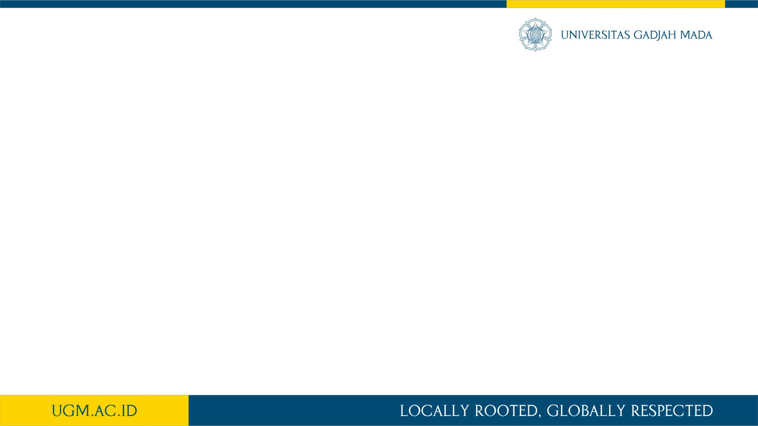
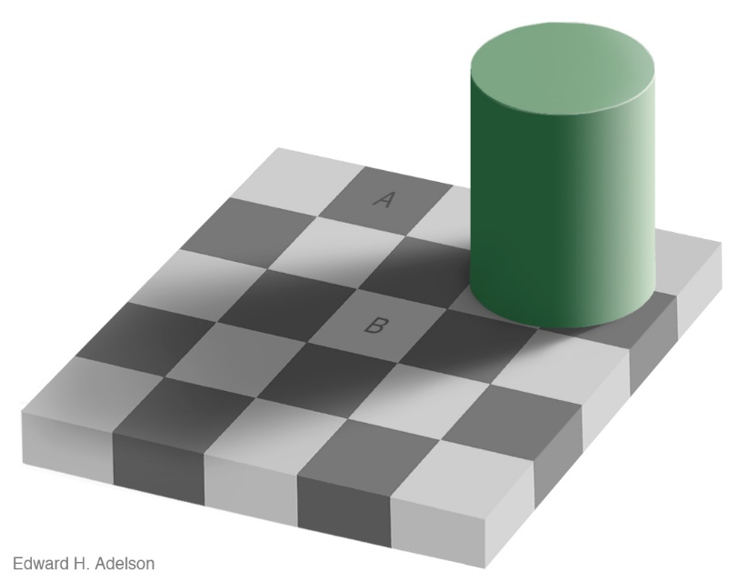
Struktur Data Citra Digital
Human eye tends to see what they want to see, instead of what they really see

Slide 4
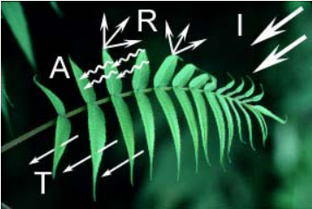
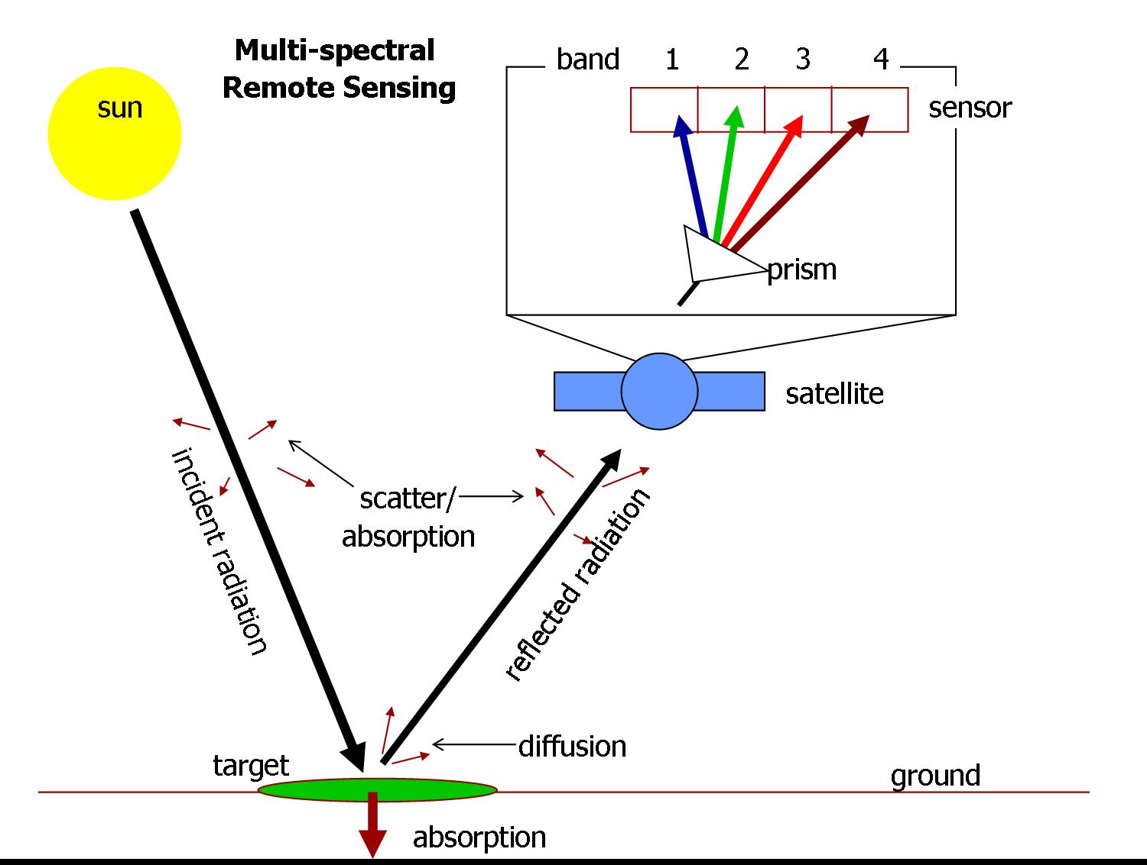
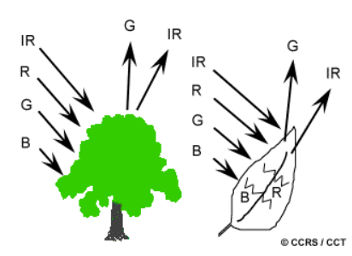
Struktur Data Citra Digital

Slide 5
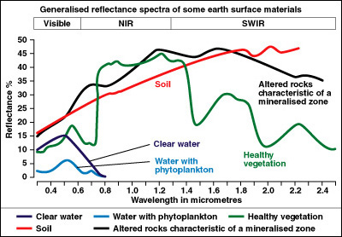
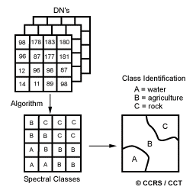
Struktur Data Citra Digital

Slide 6
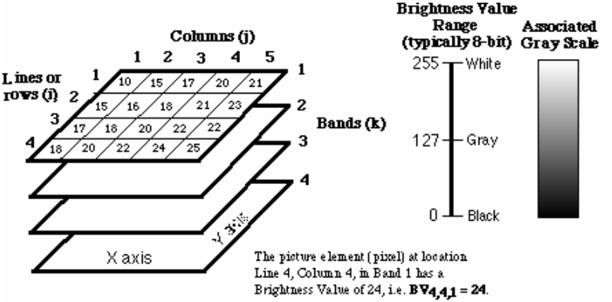
Struktur Data Citra Digital

Slide 7
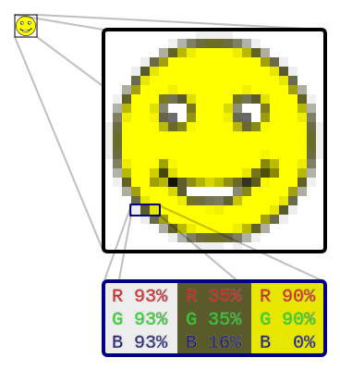
Struktur Data Citra Digital
Bagaimana warna disimpan dan disajikan pada citra digital?

Slide 8
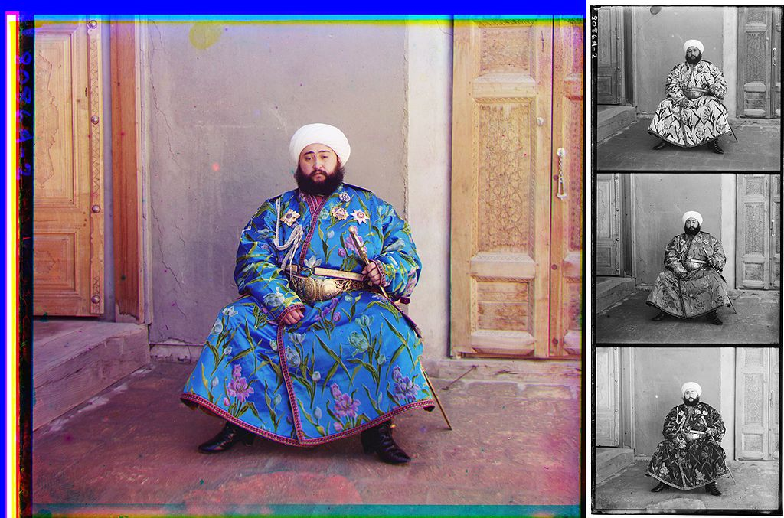

Slide 9
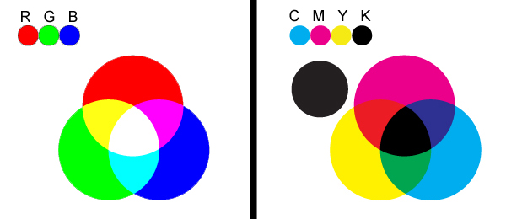
Struktur Data Citra Digital
Colorspace: bagaimana warna disimpan
Additive
Substractive

Slide 10
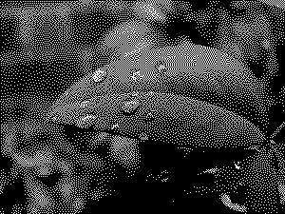
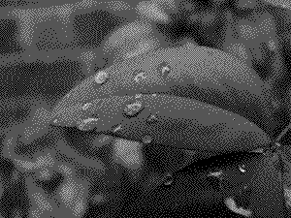
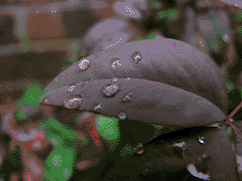
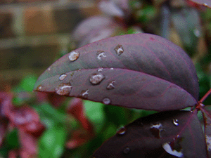

1 bit (2 colors)
2 bits (4 colors)
4 bits (16 colors, “high-color”)
8 bits (256 colors)
24 bits (16,777,216 colors, "truecolor")

Slide 11
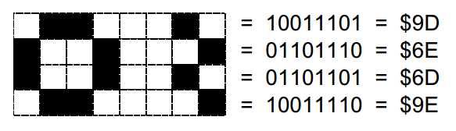
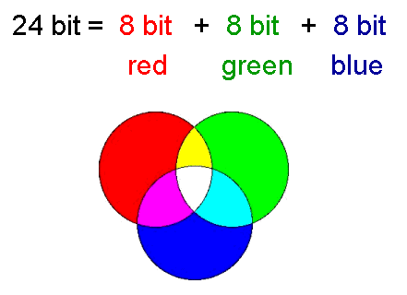
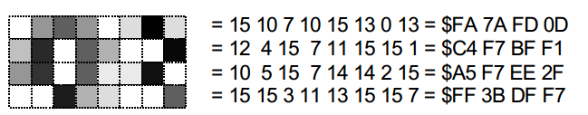
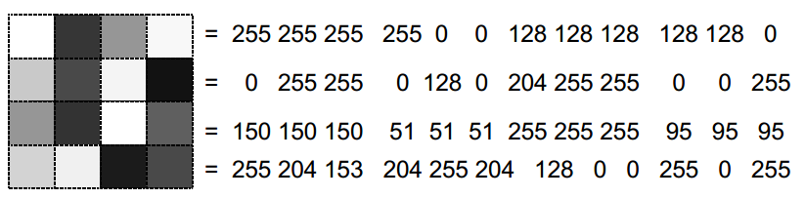
Struktur Data Citra Digital
Citra biner (monochrome)
4-bit grayscale
24-bit image space = True color
True color

Slide 12

Pengenalan OpenCV
OpenCV: Open Source Computer Vision Library
opencv.org
Developed since 1990’s in Intel
Open Source with BSD License
free for both academic and commercial use.
Designed for computational efficiency and with a strong focus on real-time applications
> 500 CV function (and counting)
Currently version 3.0 (Gold)

Slide 13
Pengenalan OpenCV
Built in C++ with binding interface to various other Programming Language
Java
Python
NodeJS
Multiple Platform
Windows
Linux/Mac
Android & iOS
Single-board Computers (Raspi, Arduino, Beagle, etc … you name it)

Slide 14

Pengenalan OpenCV

Slide 15
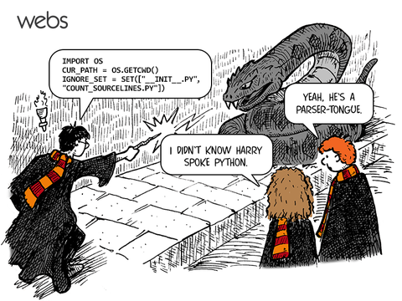

Slide 16
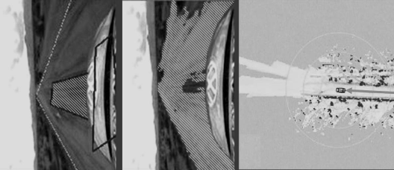
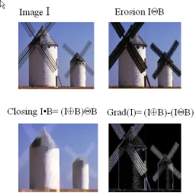
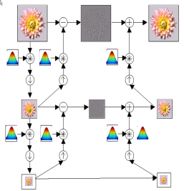
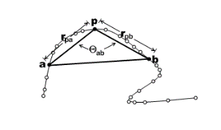
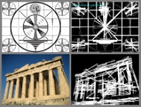
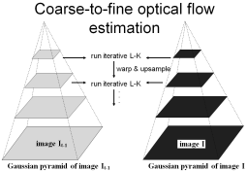
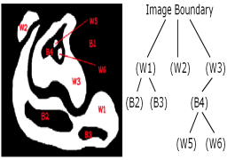
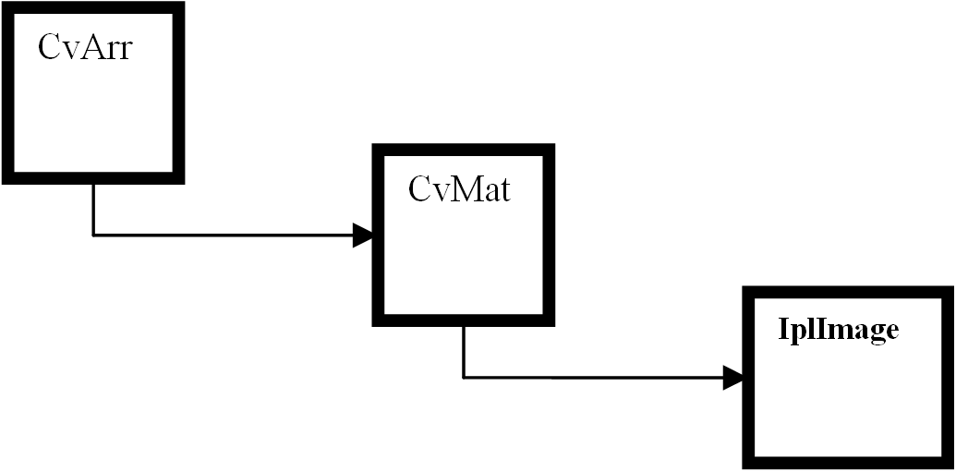
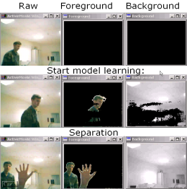
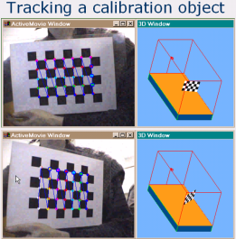
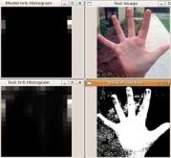
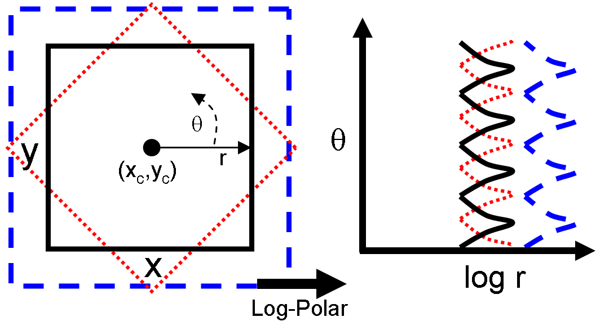
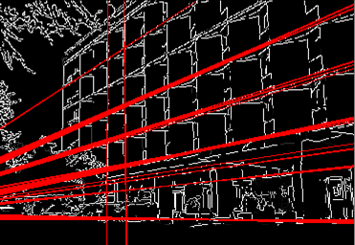
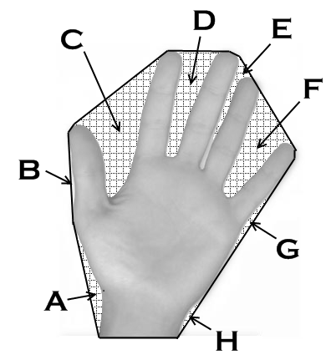
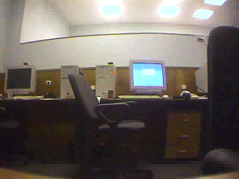
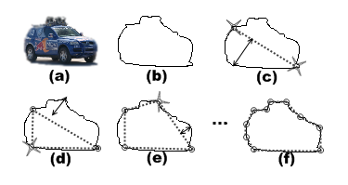
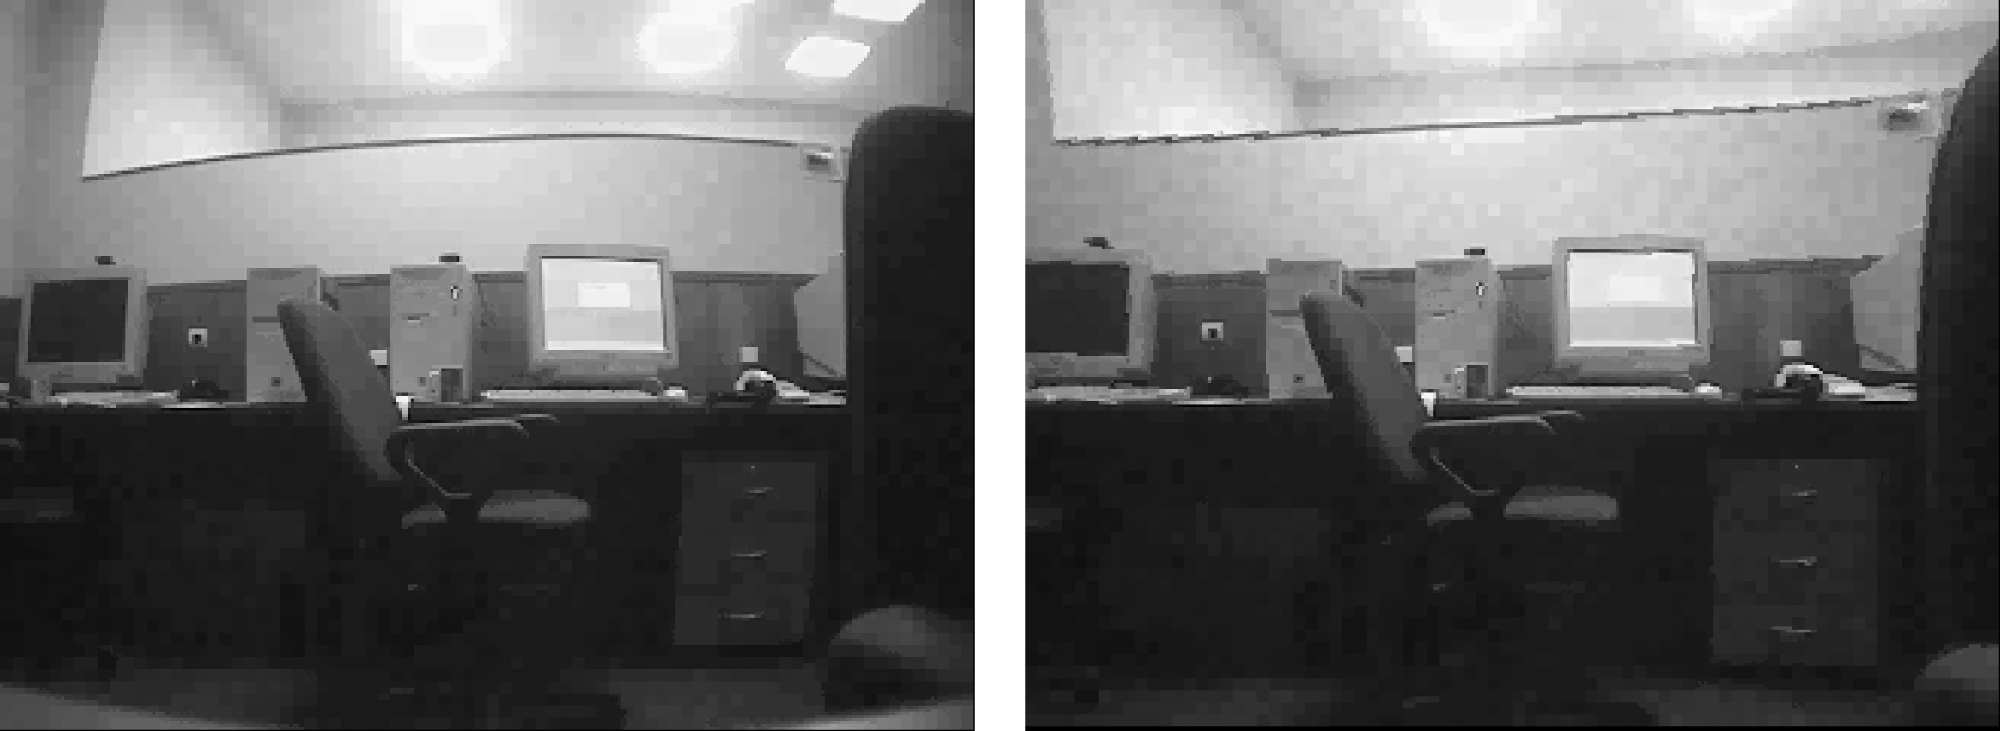
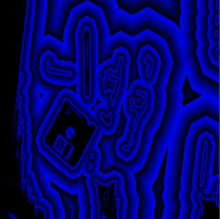
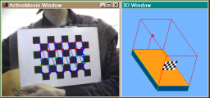
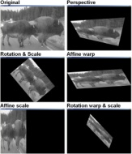
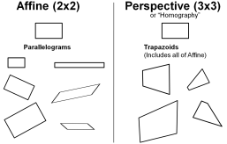
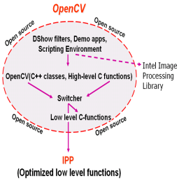
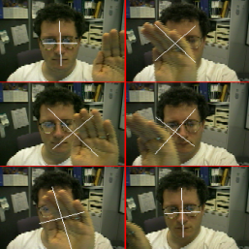
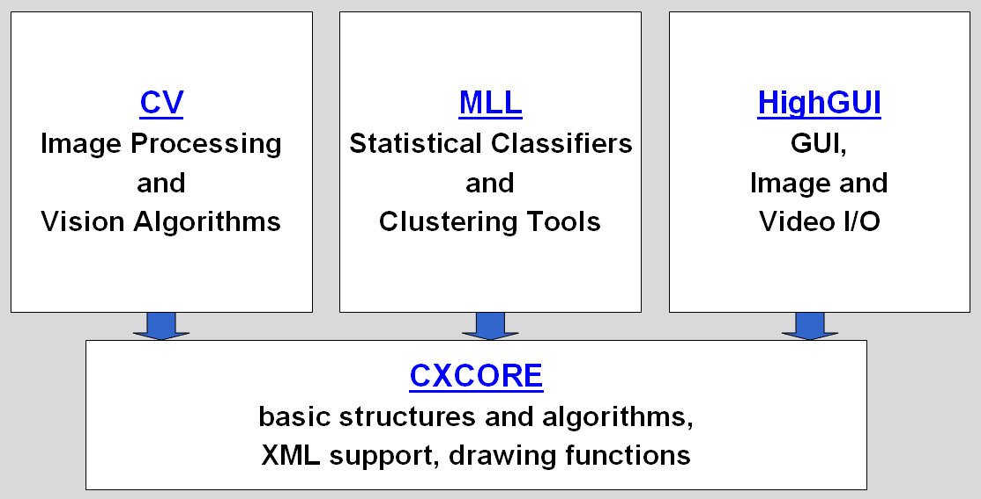
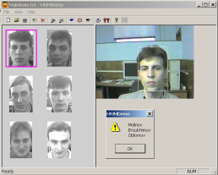
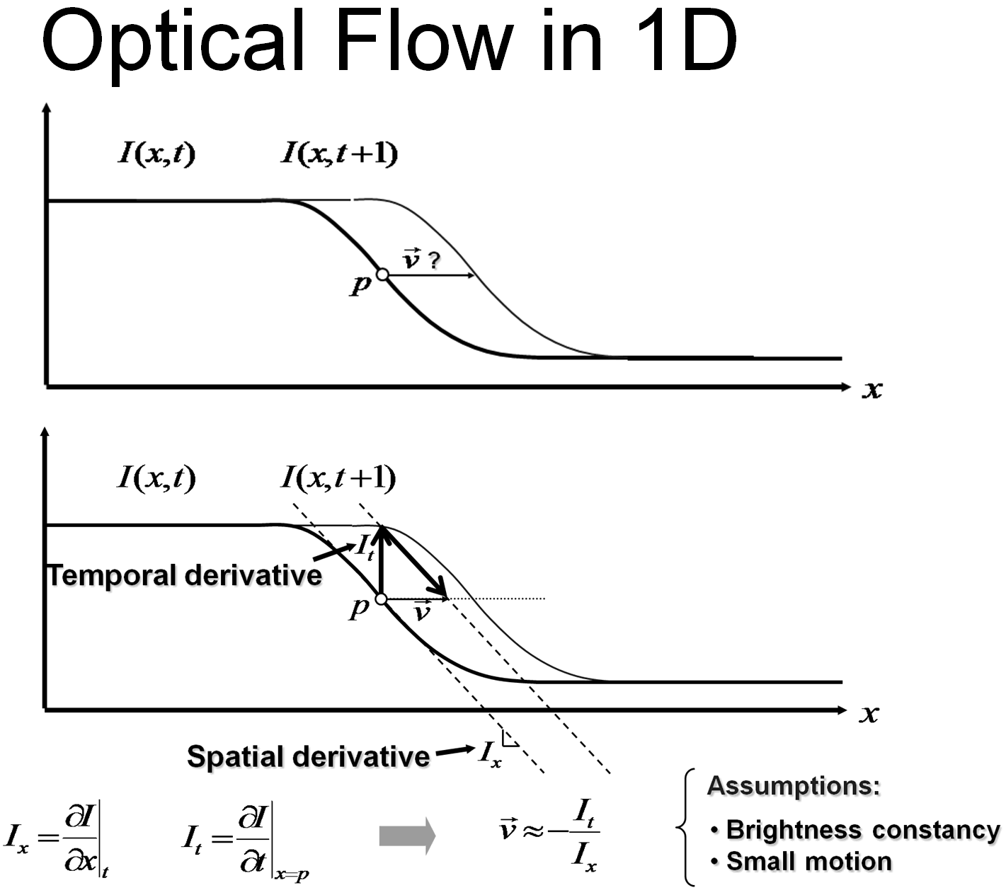
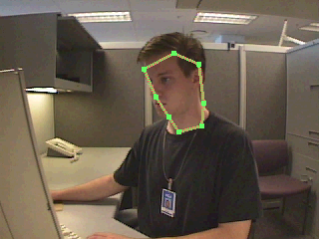
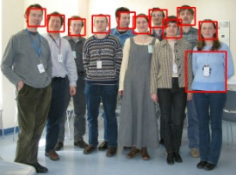
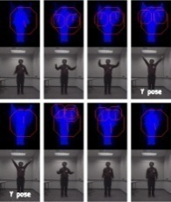





OpenCV Overview:
> 500 functions
Robot support
Opencv.org
General Image Processing Functions
Geometric
Descriptors
Image Pyramids
Segmentation
Camera
Calibration,
Stereo, 3D
Features
Transforms
Utilities and
Data Structures
Tracking
Machine Learning:
Detection,
Recognition
Matrix Math
Fitting
16
Slide Courtesy OpenCV Tutorial Gary Bradski

Slide 17



Pengenalan OpenCV

Slide 18





Pengenalan OpenCV
Computer Vision Algorithm and Application – Richard Szeliski
Learning OpenCV - O’Reilly (With CD)
Programming CV with Python - Solem
OpenCV Computer Vision with Python – Howse
Practical OpenCV – Brambhatt
https://opencv-python-tutroals.readthedocs.org/en/latest/
http://cs.brown.edu/courses/cs143/
http://www.bogotobogo.com/python/OpenCV_Python/

Slide 19

Minggu Depan
Lanjutan praktikum OpenCV

Slide 20

TERIMA KASIH

